Slide 1
Food Services Division
Dress Code Policy
Provided by the LAUSD Food Services Division
7.06.17
Notes:
TELL: Welcome to the Food Services Dress Code Policy training. Thank you for being here today. My name is (state your name).

Slide 2
Dress Code Policy
Effective February 13th, 2017 all Food Services Division (FSD) employees Managers, Seniors, Drivers, and Workers (including substitutes) must comply with the Division’s Dress Code Policy at all times during their regular assigned hours.
The Dress Code Policy will allow employees to continue to wear their uniform provided it is still in good condition and fits.
Notes:
TELL: Effective February 13th, 2017 all Food Services Division (FSD) employees Managers, Seniors, Drivers, and Workers (including substitutes) must comply with the Division’s Dress Code Policy at all times during their regular assigned hours.
The Dress Code Policy will still allow employees to continue to wear their uniform provided it is still in good condition and fits.

Slide 3
Shirts and Blouses
Food Services employees may wear:
  Café LA approved uniform top (polo or button down) provided:
    The top still fits
    Is in good condition (not stained, torn, or frayed)
  White/light colored tops
    Polos
    Smocks
    Nursing scrubs
  School’s official Spirit Day shirts
    Employees who choose not to wear the school Spirit Day shirt will be required to adhere to the standard dress code policy
Notes:
TELL: The Food Services employees may wear the Café LA approved uniform polo or button down shirts provided they still fit and are in good condition not stained, torn, or unraveled at the edges.
A FS employee who chose's not to wear the Café LA approved uniform shirt can wear a white or light colored top, polo, smock, or nursing scrub. On Friday’s employees may wear the School’s official Spirit Day shirt. If an employees chose’s not to wear the school Spirit Day shirt they will be required to adhere to the standard dress code policy.

Slide 4
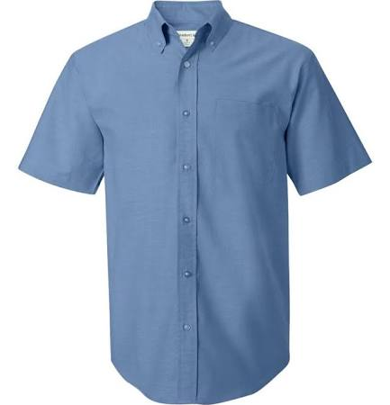
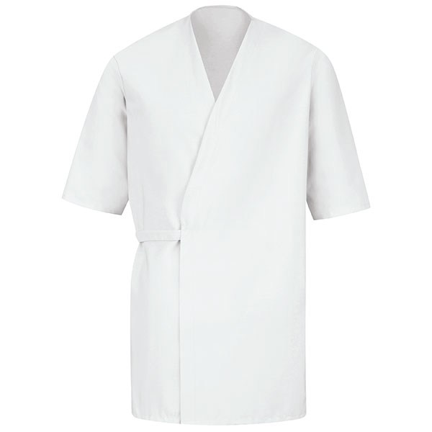
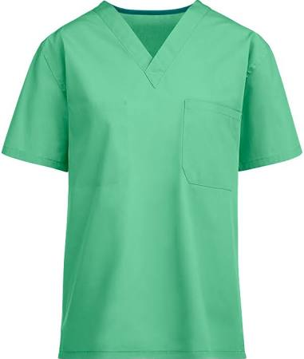
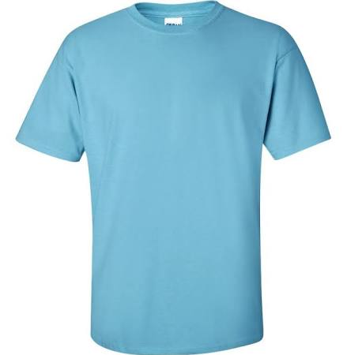
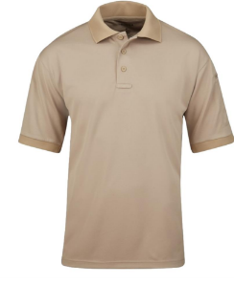
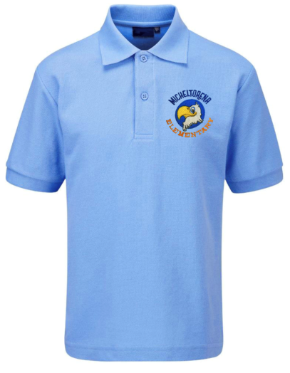
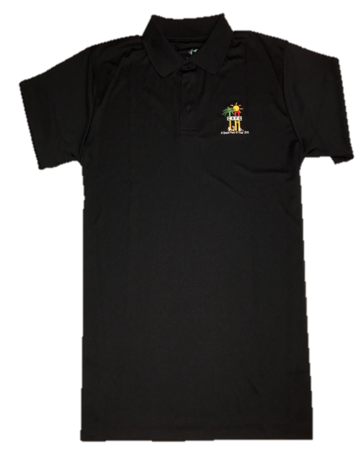
Men’s Approved Shirts
Button-Down
Smock
Scrub
T-Shirt
Polo
Café LA Polo
School Spirit Shirt
Notes:
TELL: Let’s take a look at some examples of the men’s approved shirts. The button-down, polo, smocks that wrap around your clothing, scrubs, t-shirts are all ok as long as they are in light in color, neat, and clean. Both the Cafe LA polo and button-down can be worn as long as they are in good condition. Remember, school spirit shirts can only be worn on spirit days.
All clothing choices are subject review.

Slide 5
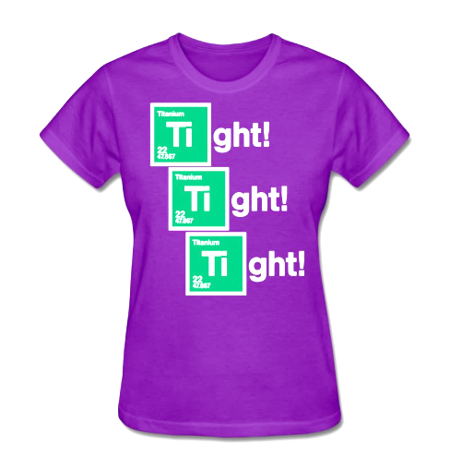
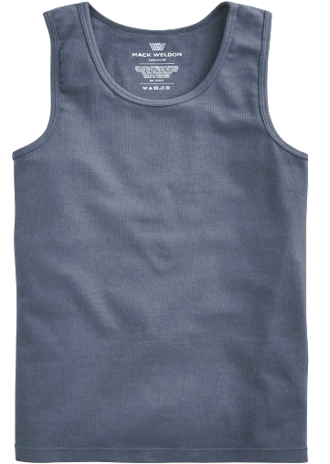
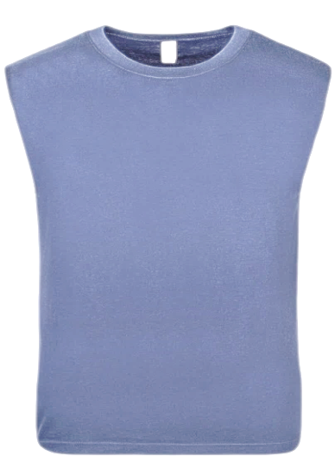
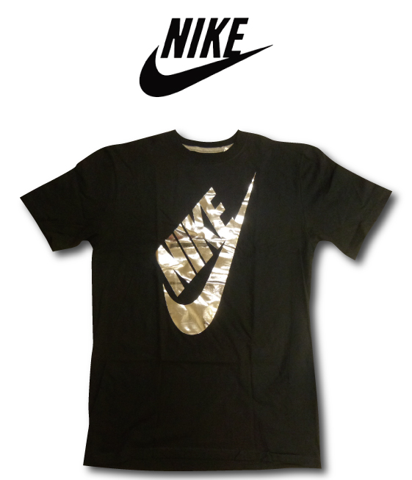
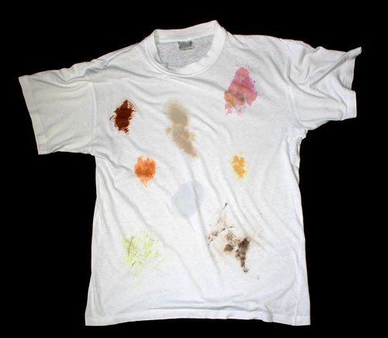
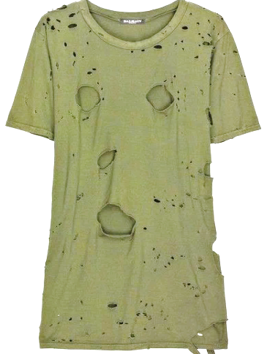
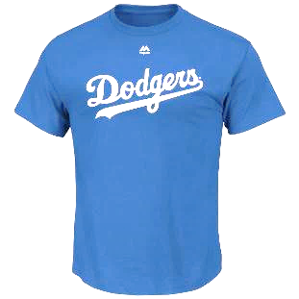
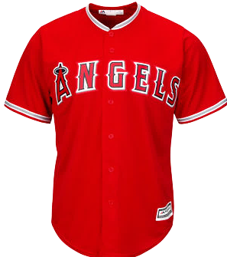
Men’s Unapproved Shirts
Tight
Tank
Logo
Dirty
Ripped
Team Apparel
Notes:
Tell: Let’s review the men’s unapproved shirts.

Slide 6
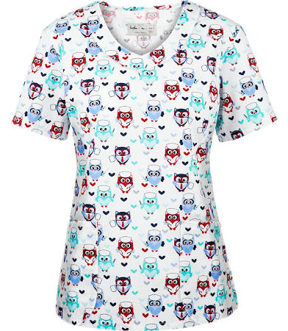
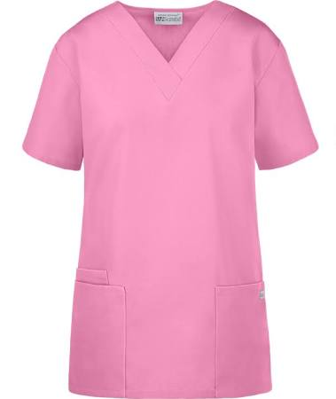
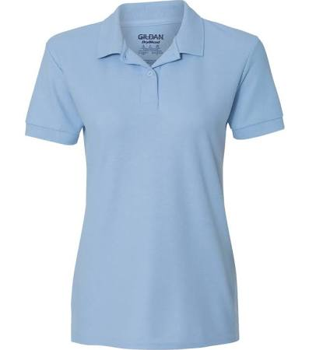
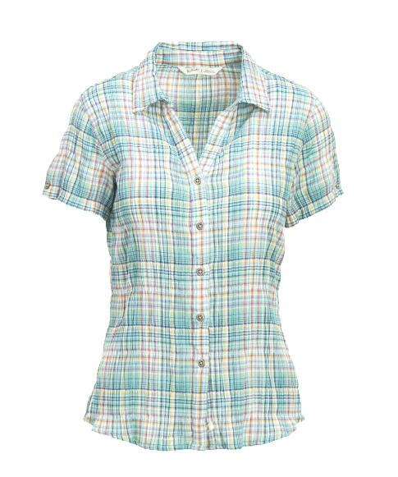
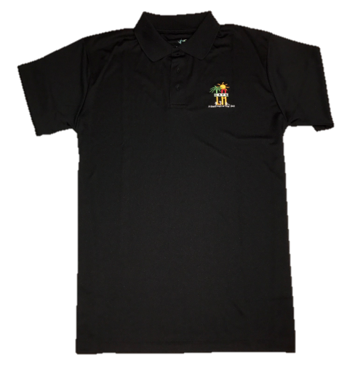
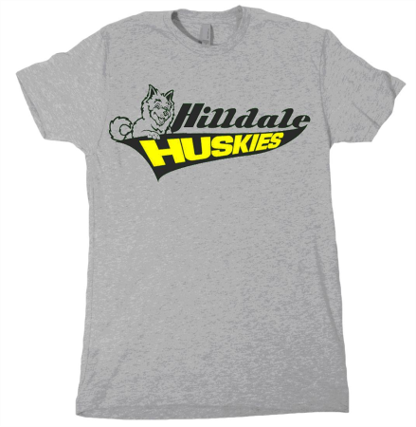
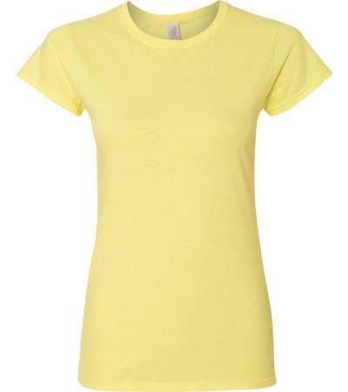
Women’s Approved Blouses
Scrub
Scrub
Polo
Button-Down
Café LA Polo
Smock
School Spirit Shirt
Blouse
Notes:
TELL: Let’s take a look at some examples of the women’s approved shirts. Women can wear button-down and polo shirts. Smocks that wrap around the clothing. Scrubs that have a design or plain in color, t-shirts are ok as long as they are light in color, neat, and clean. Both the Cafe LA polo and button-down shirts are acceptable. School spirit shirts can only be worn on spirit day.
All clothing choices are subject to review.

Slide 7
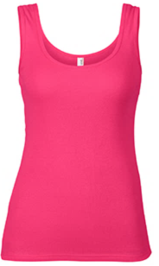
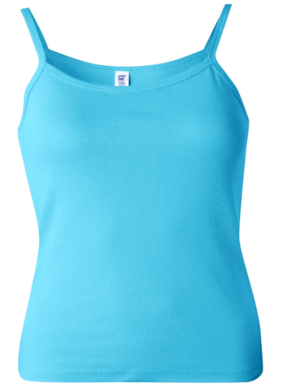
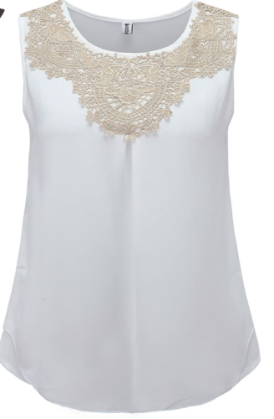
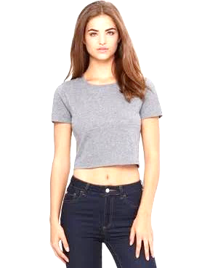
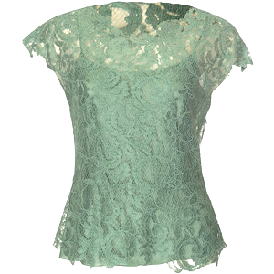
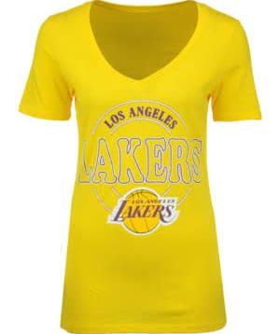
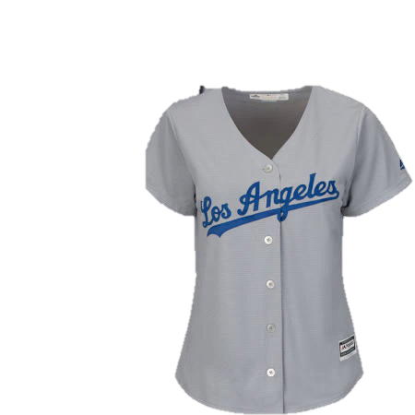
Women’s Unapproved Blouses
Tank
Spaghetti Strap
Sleeveless
Crop Top
Lace
Team Apparel
Notes:
TELL: Let’s review the women’s unapproved shirts.

Slide 8
Bottoms
Employees may wear plain black bottoms or correlating smock/nursing bottoms.
Pants:
  Must be fitted at the waist
  Not be overly baggy or too tight
  Jeans may be worn only on spirit day
Skirts:
  No shorter than knee length
  No longer than ankle length
Shorts should:
  Be fitted at the waist
  Not be overly baggy nor too tight
  Be knee length and not extend past mid-calf
Notes:
TELL: Employees may wear plain black bottoms or correlating smock/nursing bottoms. White and Khaki pants are not allowed to be worn unless they are the correlating bottoms for the smock/nurse top.
Pants must be fitted at the waist, not be overly baggy or too tight. Jeans may be worn only on spirit day. Women’s skirts can be no shorter than knee length and no longer than ankle length.
Shorts should be fitted at the waist and not be overly baggy nor too tight. The shorts should be knee length and not extend past mid-calf.

Slide 9
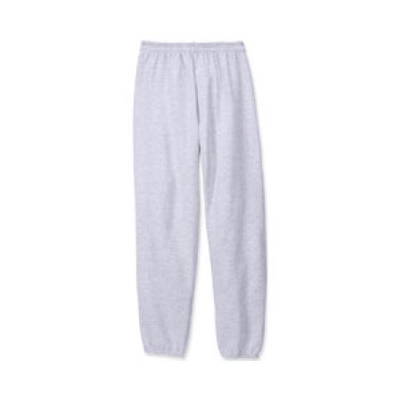
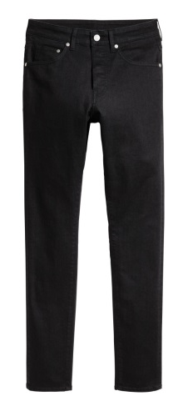
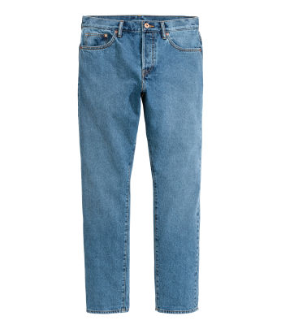
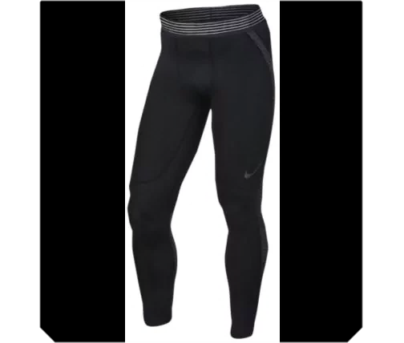
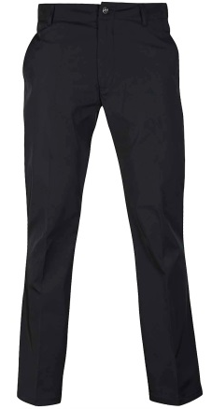
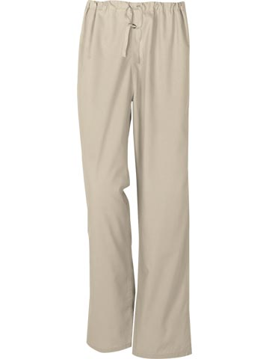
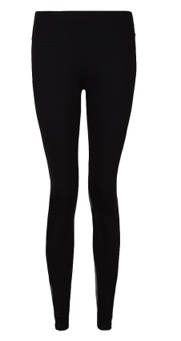
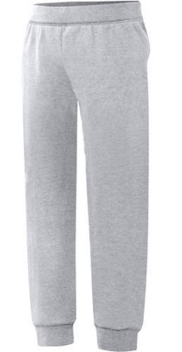
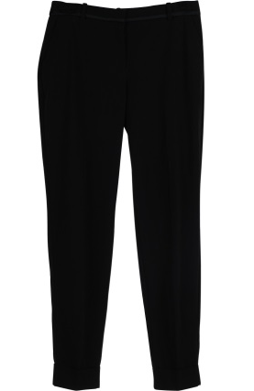
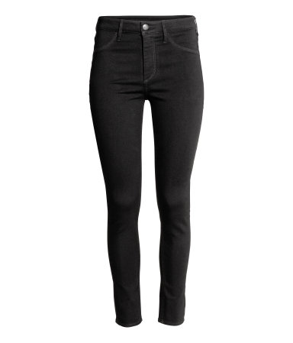
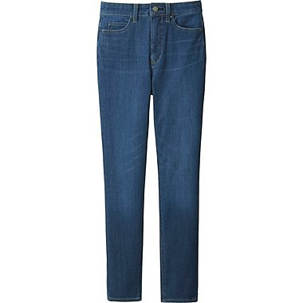
Pant’s Approved/Unapproved
Approved
Unapproved
Men
Jeans (permitted on Spirit Day)
Leggings
Sweats
Correlating
Nurse Bottoms
Plain Black
Women
Notes:
TELL: Let’s take a look at the approved pants that can be worn during work. Men and women can wear plain black pants and correlating bottoms that match their scrub shirt. Employees may not wear jeans (all colors including black), tights or sweats.

Slide 10
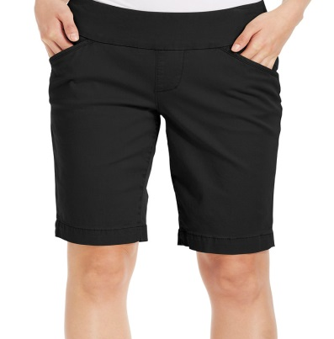
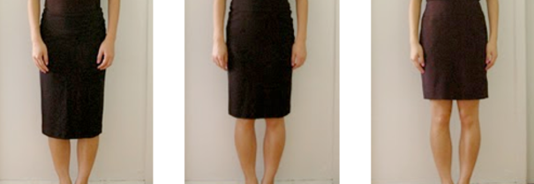
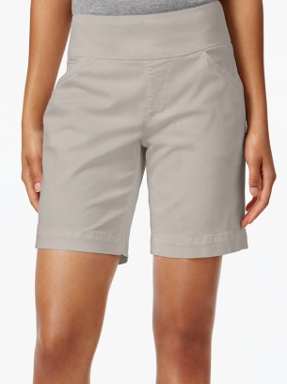
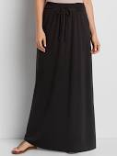
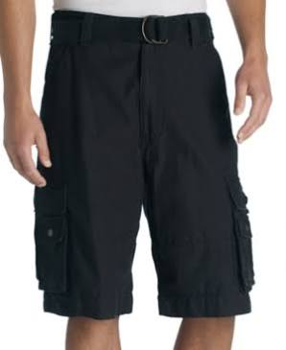
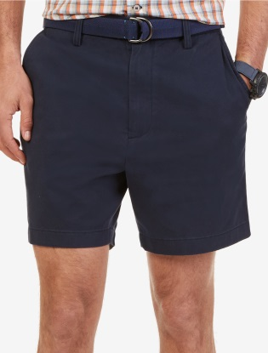
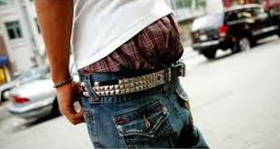
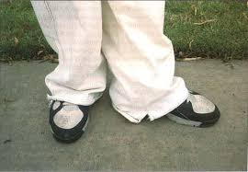
Skirts and Shorts Approved/Unapproved
Approved
Unapproved
Women
Long Skirts/Pants
Knee Length
Shorter than knee length
Men
Baggy
Notes:
TELL: Let’s take a look at the approved shorts women and men can wear. In addition, the skirt women can wear. All skirts and shorts must be knee length not longer than ankle length.. Now let’s take a look at the unapproved clothing items.

Slide 11
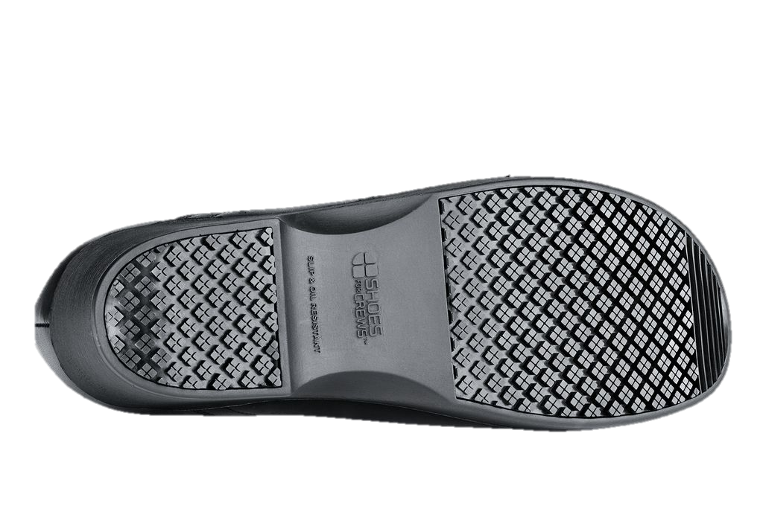
Shoes
Food Services employees work around machinery and hot foods, their feet must be adequately protected from possible injury.
Employees must wear comfortable, low or no heel closed-toe shoes with slip-resistant soles. Look for “Slip Resistant” stamped on the sole or printed on the box.
Examples are:
  Food services industry shoes
  Leather or leather-like tennis shoes
  Or other leather or leather-like shoes
Note: “Oil Resistant” does NOT mean slip resistant.
Notes:
TELL: Because Food Services employees work around machinery and hot foods, their feet must be adequately protected from possible injury. Employees must wear comfortable, low or no heel closed-toe shoes with slip-resistant soles. Look for “Slip Resistant” stamped on the sole of the shoe. Examples of approved shoes are food services industry shoes, leather or leather-like tennis shoes without any airholes, and other leather or leather-like shoes.
Note: “Oil Resistant” does NOT mean slip resistant.

Slide 12
Why Wear Slip-Resistant Shoes?
Slip resistant-shoes increase traction in slippery environments by using special sole materials and tread design to prevent falls.
A slip and fall accident at work can have serious repercussions:
  Physical, Financial, and Mental
Protecting yourself with slip resistant shoes makes you a more productive team member when you aren’t worried about:
  Slipping at work or getting hurt
Your health isn’t something to gamble with, so protect yourself with the right safety footwear.
The most dangerous part in the cafeteria is the floor.
Notes:
TELL: Why should you wear slip resistant shoes while working in the cafeteria? Because slip resistant-shoes increase traction in slippery environments by using special sole materials and tread design to prevent falls. A slip and fall accident at work can have serious repercussions physical, financial, and mental. Protecting yourself with slip resistant shoes makes you a more productive team member when you aren’t worried about slipping at work or getting hurt.
Your health isn’t something to gamble with, so protect yourself with the right safety footwear.
Remember the most dangerous part in the cafeteria is the floor.
physical – A slip and fall accident can result in broken bones, bruises, sprains and even concussions.
Financial – An injury such as those listed can leave out of work for days or even weeks.
Mental – The stress of not working while bills pile up, of not having full motor function, of having to physically recover so that you can return to work, these all affect your mental state.

Slide 13
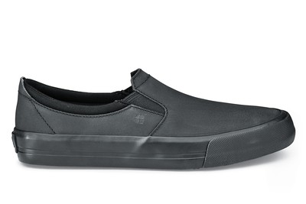











Shoes
Approved Shoes
Unapproved Shoes
Notes:
TELL: Let’s take a look at the some of the approved shoes you can wear. All the shoes are leather or leather like shoes and are slip resistant. The work clog/crocs are approved because they have no holes, an enclosed heel and have a slip resistant sole.
These are unapproved shoes that can not be worn in the cafeteria, converse, vans, mesh, and tennis shoe that have a combination of leather and mesh. The crocs are unapproved because they have holes in the shoe, do not cover the heel and are not made for the work industry. All these shoes are not slip resistant and not allowed due to safety concerns.

Slide 14



Approved Hair and Beard Covering
All employees must continue to wear the approved hairnet coverings at all times and all loose hair must be fully covered.
Employees with any facial hair must wear a beard snood.
Note: Bandanas and baseball caps are prohibited.
Notes:
TELL: All employees must continue to wear the approved hairnet coverings at all times and all loose hair must be fully covered. Employees with facial hair must wear a beard snood, this includes mustaches.
Bandanas and all hats are prohibited.

Slide 15


Religious Head Covering
Employees wearing religious/ethnic head coverings may continue to do so provided it does not pose a safety or sanitation concern.
  If the head covering poses a potential safety or sanitation concern, a meeting will be held with the immediate supervisor and/or HR to discuss possible accommodations.
Notes:
TELL: Employees wearing religious/ethnic head coverings may continue to do so provided it does not pose a safety or sanitation concern. If the head covering poses a potential safety or sanitation concern, a meeting will be held with the immediate supervisor and/or HR to discuss possible accommodations. Hairnets should be over hair. However due to the sensitivity of some religions, if the headwear reasonably shows that no hair will escape, Managers are not required to ask employees to take off their covering for proof that an hairnet is underneath. If the head covering is loose and hangs down where it is a sanitary concern, the employee will need to tuck or pin the clothes to insure sanitation.

Slide 16


Example of Appropriate Work Attire
Clean Hair/Hairnet
No Facial Jewelry
White/Light Clothing
Short, Clean Nails (No Polish, Acrylic or Coated Nails)
No Watch, Plain Ring
Clean Apron
Bottoms are not tight or baggy
Low/No-Heeled, Closed-Toe Slip Resistant Shoe
Notes:
TELL: Here is an example of a Food Services Worker wearing the appropriate attire to work.

Slide 17
Newman Nutrition Center
Employees at Newman Nutrition Center will be provided smocks daily at the start of their assignment to be worn over their clothes.
  Smocks are to be returned at the end of each day upon clocking out of their assignment.
Notes:
TELL: Employees at Newman Nutrition will be provided smocks daily at the start of their assignment to be worn over their clothes.
The smocks are to be returned at the end of each day upon clocking out of their assignment.

Slide 18
Personal Protective Equipment
Personal protective equipment (PPE) such as; oven mitts, oven sleeves, aprons, cotton gloves, face masks, and eye protection must be used as intended and directed by the Division.
Accidents occurring as a result of actions in violation of Food Services Division or District policy, or clearly unsafe practice/behavior, can result in employees receiving an:
  Incident log for working unsafely and/or disciplinary action
Notes:
TELL: Personal protective equipment (PPE) (such as oven mitts, sleeves, aprons, eye protection, etc.) must be used as intended and directed by the Division.
Accidents occurring as a result of a practice in violation of Food Services Division or District policy, or clearly an unsafe practice/behavior, can result in employees receiving an incident log for working unsafely and/or disciplinary action.

Slide 19
Personal Protective Equipment Cont.
Listed below are some samples of the personal protective equipment that should be used as directed.
Safety Googles
Oven Mitt
Oven Sleeve
Cotton Gloves
Face Mask
Notes:
TELL: Let’s take a look at a few of the personal protective equipment that we have in the cafeteria and use on a daily basis to protect ourselves from injury. The items described above are only a summary. Please refer to the Food Services Division Guidelines, Policies & Procedures and HACCP requirements for a complete list.

Slide 20
A special thank you to the Food Service employees who volunteered for photos.
Dana Pozo (Dena Elementary)
Maria Elena (Bell High School)
Tania Ara (Contreras Learning Center)
Notes:
ASK: Are there any related questions pertaining to the dress code policy training we have just reviewed?
TELL: This concludes the training, thank you.

Slide 21
Questions?
Thank you!
LAUSD Food Services Division
Nourishing Children to Achieve Excellence
Notes:
ASK: Are there any related questions pertaining to the dress code policy training we have just reviewed?
TELL: This concludes the training, thank you.

